Slide 1
ASSIGNMENT 1
By
Surya Loganathan

Slide 2
Differentiate between data and information?
S.no | Data | Information
1. | Data is an individual unit that contains raw materials which do not carry any specific meaning. | Information is a group of data that collectively carries a logical meaning.
2. | Data follows the form of letters, numbers, or characters and is structured in graphs, data trees, flowcharts, or tables. | Information follows the format of ideas or references and is represented as ideas, thoughts, and languages after collating the data acquired
3. | Data is information collected. | Information is data processed.
4. | Data is measured in bits and bytes. | Information measured in quantity, time.
5. | Data alone doesn’t sufficient for decision making. | Information alone is sufficient for decision making.
6. | Examples: weights, price, and costs, numbers of items sold, employee names, etc., | Examples: transaction processing systems, decision support systems, knowledge management systems, etc.,

Slide 3
How data is useful for us?
Data is useful for,
Informed decision-making
Problem-solving
Greater understanding
Improving processes
Strategic Approaches

Slide 4
What is Big data?
Data that are very large in size is called Big data.
Big data sets can be structured, semi-structured, and unstructured and are frequently analysed to discover applicable patterns and insights about the user and machine activity.
These data come from many sources like Social networking sites, E-commerce sites, Weather stations, Telecom companies, and Share Market.

Slide 5
Differentiate between structured, semi-structured, and unstructured data.
S.no | Structured Data | Unstructured Data | Semi-Structured Data
1. | Structured data is a type of data that is organized in a specific way. | Unstructured data is data that is not stored in a predefined format. | Semi-structured data combine unstructured and structured data.
2. | Ex: Numbers, dates and Strings. | Ex: Images, Video files, Audio file Formats, Emails. | Ex: JSON files, HTML web pages, CSV files.
3. | It works on the basis of relational database tables. | It works on the basis of binary data and the available characters. | It works on the basis of Relational Data Framework(RDF) or XML
4. | Versioning over tuples, row, tables. | Versioning over tuples or graph is possible. | Versioned as a whole.

Slide 6
What are qualitative data and quantitative data?
Quantitative data
Quantitative data is anything that can be counted or measured.
Tells us how many, how much, or how often.
Analysed using statistical analysis.
Qualitative data
Qualitative data is descriptive, referring to things that can be observed but not measured.
Describes certain attributes, and helps us to understand the “why” or “how” behind certain behaviors.
Analysed by grouping the data into meaningful themes or categories.

Slide 7
What are the different V’s in big data?
Different V’s in big data is,
Variety
Volume
Value
Veracity
Velocity

Slide 8
Name some popular tools used in big data.
Hadoop
Apache Storm
MongoDB
Cassandra
Cloudera
Open Refine
Flink
Kaggle

Slide 9
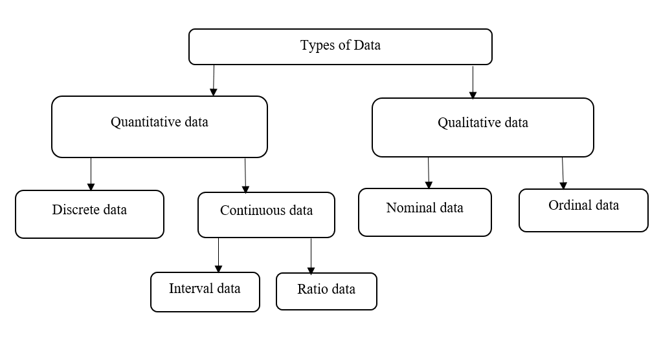
What are the different types of data? Explain.

Slide 10
Quantitative data:
Quantitative data can be expressed as a number or can be quantified. It can be measured by numerical variables.
Discrete data:
Discrete data is a count that involves only integers. The discrete values cannot be subdivided into parts.
Example: The number of students in a class.
Continuous Data:
Continuous data could be meaningfully divided into finer levels. It can be measured on a scale and can have any numeric value.
Example: The amount of time required to complete a project.

Slide 11
Interval data:
Interval data refers to information measured along a scale with equal distances.
Example: Celsius and Fahrenheit are examples of interval scales.
Ratio data:
Ratio data is quantitative data that has an equal and definitive ratio between each value.
Qualitative data:
Qualitative data can’t be expressed as a number and can’t be measured. Qualitative data consist of words, pictures, and symbols, not numbers.

Slide 12
Nominal data:
Nominal data is used just for labeling variables, without any type of quantitative value.
Example: Gender, Marital status, Hair color.
Ordinal Data:
Ordinal data is data that is placed into some kind of order by their position on a scale.
Example: Economic status: low, medium, and high.

